Slide 1
Java Swing

Slide 2
Swing: An Overview
Lightweight- Not built on native window-system windows.
Much bigger set of built-in controls. Trees, image buttons, tabbed panes, sliders, toolbars, color choosers, tables, text areas to display HTML or RTF, etc.
More customizable. Can change border, text alignment, or add image to almost any control. Can customize how minor features are drawn.
"Pluggable" look and feel. Can change look and feel at runtime, or design own look and feel.
Many miscellaneous new features. Double-buffering built in, tool tips, dockable tool bars, custom cursors, etc.

Slide 3
Swing
Components are named JXxx. e.g. JFrame, JPanel, JApplet, JDialog, JButton, etc.
There is an almost-equivalent Swing component for most AWT components.
Do drawing in paintComponent, not paint.
Instead of adding components directly to frames or applets, use the content pane
  Add to content pane via getContentPane().add
  Replace content pane via setContentPane

Slide 4
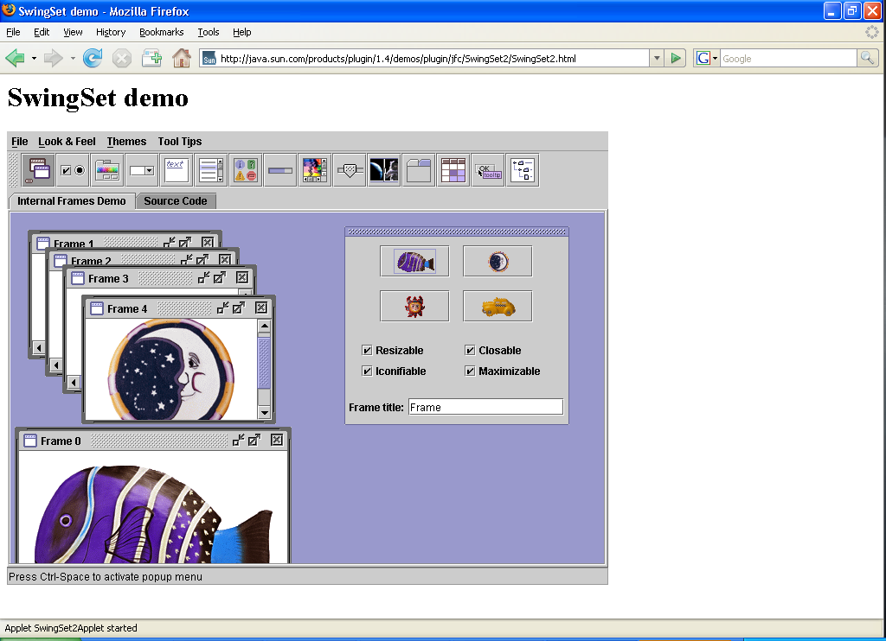
Swing Demo
http://java.sun.com/products/plugin/1.4/demos/plugin/jfc/SwingSet2/SwingSet2.html

Slide 5
Mixing AWT & SWING
Mixing AWT and Swing is not a good idea.
Stick with the AWT or move completely to Swing.

Slide 6
JFrame
Components go in the "content pane", not directly in the frame.
Changing other properties (layout manager, background colour, etc.) also apply to the content pane.
Access content pane via getContentPane, or if you want to replace the content pane with your container (e.g. a JPanel), use setContentPane.

Slide 7
JFrame (cont’d)
JFrames close automatically when you click on the close button (unlike AWT Frames). However, closing the last JFrame does not result in your program exiting Java. So your "main" JFrame still needs a WindowListener.
You get Java (Metal) look by default, so you have to explicitly switch if you want native look.

Slide 8
JFrame Example-I
import java.awt.*;
import javax.swing.*;
public class JFrameSample {
public static void main(String[] args) {
JFrame f = new JFrame("This is a test");
f.setSize(400, 150);
Container content = f.getContentPane();
content.setBackground(Color.LIGHT_GRAY);
content.setLayout(new FlowLayout());
content.add(new JButton("Button 1"));
content.add(new JButton("Button 2"));
f.setVisible(true);
}
}

Slide 9
JFrame Example-II
import java.awt.*;
import javax.swing.*;
public class JFrameSample {
public static void main(String[] args) {
try {
UIManager.setLookAndFeel(UIManager.getSystemLookAndFeelClassName());
} catch(Exception e) {
System.out.println("Error setting native Look & Feel: " + e);
}
JFrame f = new JFrame("This is a test");
f.setSize(400, 150);
Container content = f.getContentPane();
content.setBackground(Color.LIGHT_GRAY);
content.setLayout(new FlowLayout());
content.add(new JButton("Button 1"));
content.add(new JButton("Button 2"));
f.setVisible(true);
}
}

Slide 10
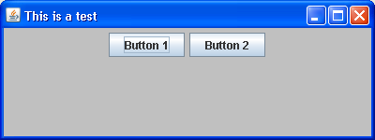
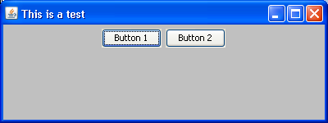
Running JFrame Examples- I, II

Slide 11
GUI Component API
Java: GUI component = class
Properties
Methods
Events
JButton
Source: Chris North, Java Swing, Virginia Tech, infovis.cs.vt.edu/GUI/java/Java2-Swing.ppt

Slide 12
Using a GUI Component
Create it
    Instantiate object: b = new JButton(“press me”);
Configure it
    Properties: b.text = “press me”; [avoided in java]
    Methods: b.setText(“press me”);
Add it
    panel.add(b);
Listen to it
    Events: Listeners
JButton
Source: Chris North, Java Swing, Virginia Tech, infovis.cs.vt.edu/GUI/java/Java2-Swing.ppt

Slide 13
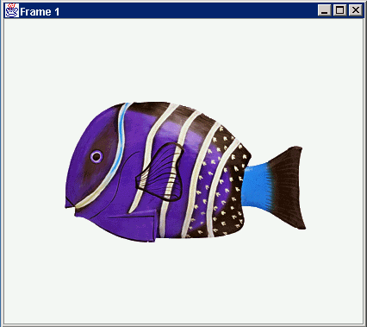
Anatomy of an Application GUI
GUI
Internal structure
JFrame
JFrame
JPanel
containers
JPanel
JButton
JButton
JLabel
JLabel
Source: Chris North, Java Swing, Virginia Tech, infovis.cs.vt.edu/GUI/java/Java2-Swing.ppt

Slide 14
Using a GUI Component 2
Create it
Configure it
Add children (if container)
Add to parent (if not JFrame)
Listen to it
order
important
Source: Chris North, Java Swing, Virginia Tech, infovis.cs.vt.edu/GUI/java/Java2-Swing.ppt

Slide 15
Build from bottom up
Create:
    Frame
    Panel
    Components
    Listeners
Add: (bottom up)
    listeners into components
    components into panel
    panel into frame
Listener
JLabel
JButton
JPanel
JFrame
Source: Chris North, Java Swing, Virginia Tech, infovis.cs.vt.edu/GUI/java/Java2-Swing.ppt

Slide 16
Code
JFrame f = new JFrame(“title”);
JPanel p = new JPanel( );
JButton b = new JButton(“press me”);
p.add(b); // add button to panel
f.setContentPane(p); // add panel to frame
f.show();
press me
Source: Chris North, Java Swing, Virginia Tech, infovis.cs.vt.edu/GUI/java/Java2-Swing.ppt

Slide 17
Application Code
import javax.swing.*;
class hello {
public static void main(String[] args){
JFrame f = new JFrame(“title”);
JPanel p = new JPanel();
JButton b = new JButton(“press me”);
p.add(b); // add button to panel
f.setContentPane(p); // add panel to frame
f.show();
}
}
press me
Source: Chris North, Java Swing, Virginia Tech, infovis.cs.vt.edu/GUI/java/Java2-Swing.ppt

Slide 18
Listen to it
...
setDefaultCloseOperation(javax.swing.WindowConstants.EXIT_ON_CLOSE);
b.addActionListener(new java.awt.event.ActionListener() {
public void actionPerformed(java.awt.event.ActionEvent evt) {
bActionPerformed(evt);
}
....
private void bActionPerformed(java.awt.event.ActionEvent evt) {
// TODO add your handling code here:
JOptionPane p = new JOptionPane.showMessageDialog(getContentPane(), evt, "title", 50, null);
}
...

Slide 19
Top-Level Containers
Swing provides three generally useful top-level container classes:
JFrame,
JDialog,
and JApplet.

Slide 20
Containers
To appear onscreen, every GUI component must be part of a containment hierarchy. A containment hierarchy is a tree of components that has a top-level container as its root.
Each GUI component can be contained only once. If a component is already in a container and you try to add it to another container, the component will be removed from the first container and then added to the second.

Slide 21
Content pane & Menu
Each top-level container has a content pane that, generally speaking, contains (directly or indirectly) the visible components in that top-level container's GUI.
You can optionally add a menu bar to a top-level container. The menu bar is by convention positioned within the top-level container, but outside the content pane.

Slide 22
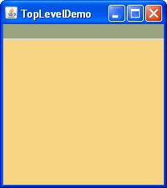
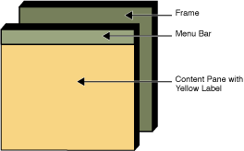
JFrame
http://java.sun.com/docs/books/tutorial/uiswing/components/toplevel.html

Slide 23
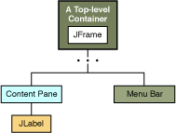
Containment Hierarchy - Example

Slide 24
Look and Feel (LAF)
Default is "Java LAF" (or "Metal"), a custom look and feel similar to the Windows look.
Changing the Look and Feel:
try { UIManager.setLookAndFeel(UIManager.getSystemLookAndFeelClassName());
} catch(Exception e) {
System.out.println("Error setting native LAF: " + e);
}
....
try { UIManager.setLookAndFeel(UIManager.getCrossPlatformLookAndFeelClassName());
} catch(Exception e) {
System.out.println("Error setting Java LAF: " + e);
}

Slide 25
JLabel
With the JLabel class, you can display unselectable text and images.
If you need to create a component that displays a string, an image, or both, you can do so by using or extending JLabel.
If the component is interactive and has a certain state, use a button instead of a label.
By specifying HTML code in a label's text, you can give the label various characteristics such as multiple lines, multiple fonts or multiple colors.

Slide 26
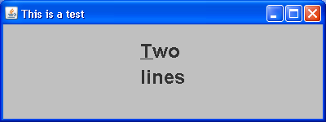
HTML in Swing Components
o specify that a component's text has HTML formatting, just put the <html> tag at the beginning of the text, then use any valid HTML in the remainder. Here is an example of using HTML in a button's text:
label = new JLabel("<html><h1><b><u>T</u>wo</b><br>lines</h1></html>");

Slide 27
JLabel Example
ImageIcon icon = createImageIcon("images/middle.gif");
. . .
label1 = new JLabel("Image and Text", icon, JLabel.CENTER);
//Set the position of the text, relative to the icon: label1.setVerticalTextPosition(JLabel.BOTTOM); label1.setHorizontalTextPosition(JLabel.CENTER); label2 = new JLabel("Text-Only Label");
label3 = new JLabel(icon);

Slide 28
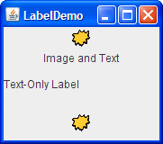
http://java.sun.com/docs/books/tutorial/uiswing/components/label.html

Slide 29
Menus
A menu provides a space-saving way to let the user choose one of several options. Other components with which the user can make a one-of-many choice include combo boxes, lists, radio buttons, spinners, and tool bars.

Slide 30
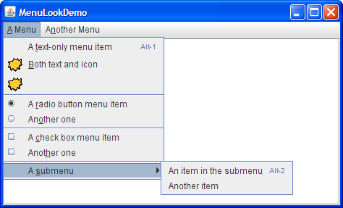
Example
Source: http://java.sun.com/docs/books/tutorial/uiswing/components/menu.html

Slide 31
Creating Menus
/Where the GUI is created:
JMenuBar menuBar;
JMenu menu, submenu;
JMenuItem menuItem;
JRadioButtonMenuItem rbMenuItem;
JCheckBoxMenuItem cbMenuItem;
//Create the menu bar. menuBar = new JMenuBar();

Slide 32
Creating Menus (cont’d)
//Build the first menu.
menu = new JMenu("A Menu"); menu.setMnemonic(KeyEvent.VK_A); menu.getAccessibleContext().setAccessibleDescription( "The only menu in this program that has menu items");
menuBar.add(menu);

Slide 33
Creating Menus (cont’d)
//a group of JMenuItems
menuItem = new JMenuItem("A text-only menu item", KeyEvent.VK_T); menuItem.setAccelerator(KeyStroke.getKeyStroke( KeyEvent.VK_1, ActionEvent.ALT_MASK));
menuItem.getAccessibleContext().setAccessibleDescription( "This doesn't really do anything");
menu.add(menuItem); menuItem = new JMenuItem("Both text and icon", new ImageIcon("images/middle.gif"));
menuItem.setMnemonic(KeyEvent.VK_B);
menu.add(menuItem); menuItem = new JMenuItem(new ImageIcon("images/middle.gif"));
menuItem.setMnemonic(KeyEvent.VK_D);
menu.add(menuItem);

Slide 34
Creating Menus (cont’d)
//a submenu
menu.addSeparator();
submenu = new JMenu("A submenu"); submenu.setMnemonic(KeyEvent.VK_S);
menuItem = new JMenuItem("An item in the submenu"); menuItem.setAccelerator(KeyStroke.getKeyStroke( KeyEvent.VK_2, ActionEvent.ALT_MASK));
submenu.add(menuItem);
menuItem = new JMenuItem("Another item"); submenu.add(menuItem);
menu.add(submenu);

Slide 35
Creating Menus (cont’d)
//Build second menu in the menu bar.
menu = new JMenu("Another Menu"); menu.setMnemonic(KeyEvent.VK_N); menu.getAccessibleContext().setAccessibleDescription( "This menu does nothing");
menuBar.add(menu);
...
frame.setJMenuBar(theJMenuBar);

Slide 36
Acknowledgements
Core Web Programming, by Marty Hall and Larry Brown, Sun Microsystems Press/Prentice Hall PTR.
Chris North, Java Swing, Virginia Tech, infovis.cs.vt.edu/GUI/java/Java2-Swing.ppt

